Slide 1
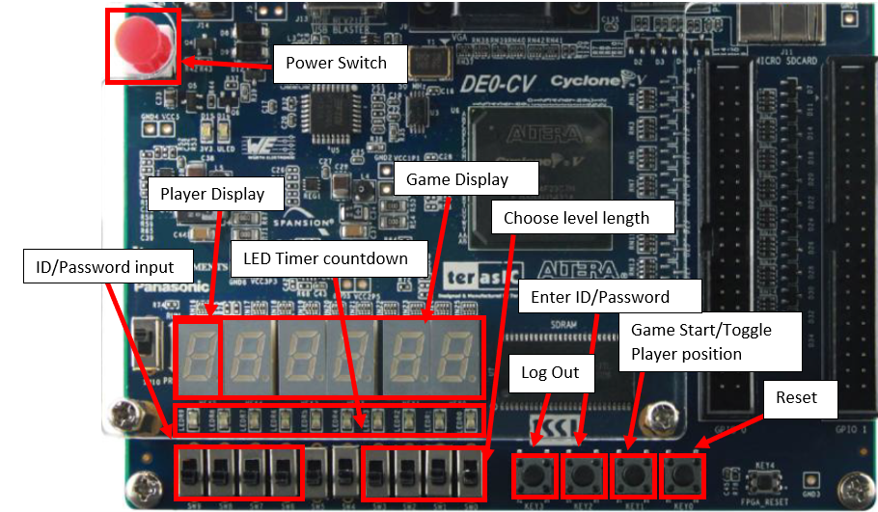
Asteroid Dodge Game: With Multi-User ROM-based Authentication, RAM-based Score Tracking, Difficulty Levels, and Adjustable Timer
ECE 5440: Advanced Digital Design, Spring 2022
Team Q4
Nhat Nguyen
Christopher Andrew
Gantabya Kadel
Matt Andersen
Notes:
Nhat

Slide 2
Abstract
This FPGA tech demo showcases team Q4’s custom and unique interpretation of the requirements outlined by the class instructor. The premise is a side-scrolling object dodging game, where the player must survive until the timer is up. The project features specific requirements: adjustable timer, game “levels” that automatically increase in difficulty, multi-user authentication, and score tracking. The project is successfully synthesized and tested with all of the features working.

Slide 3


Gameplay
Log in
See score screen, Key1 to start
User can adjust fuel gauge with SW0-SW3 before starting
After start, user is placed into game, they must dodge with Key1
User doesn’t crash when fuel gauge runs out--level win
Score is displayed, user pushes Key1 to start next level
Difficulty increases by 1, caps at 3
If high school, LED animation plays
User does another run, crashes
Scores display--user can log out or restart
Notes:
Nhat

Slide 4
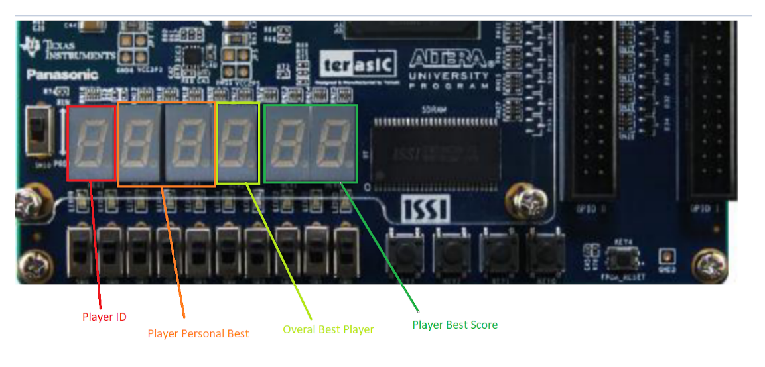
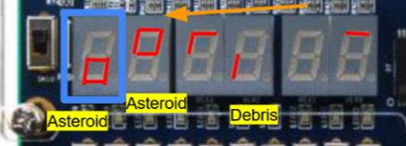
Game Feature Overview
Player must dodge incoming projectiles
Player adjustable level length
Longer is more difficult
Object speed increases over time
Score tracking and top score tracking for 4 players
Score Display
Notes:
Chris

Slide 5
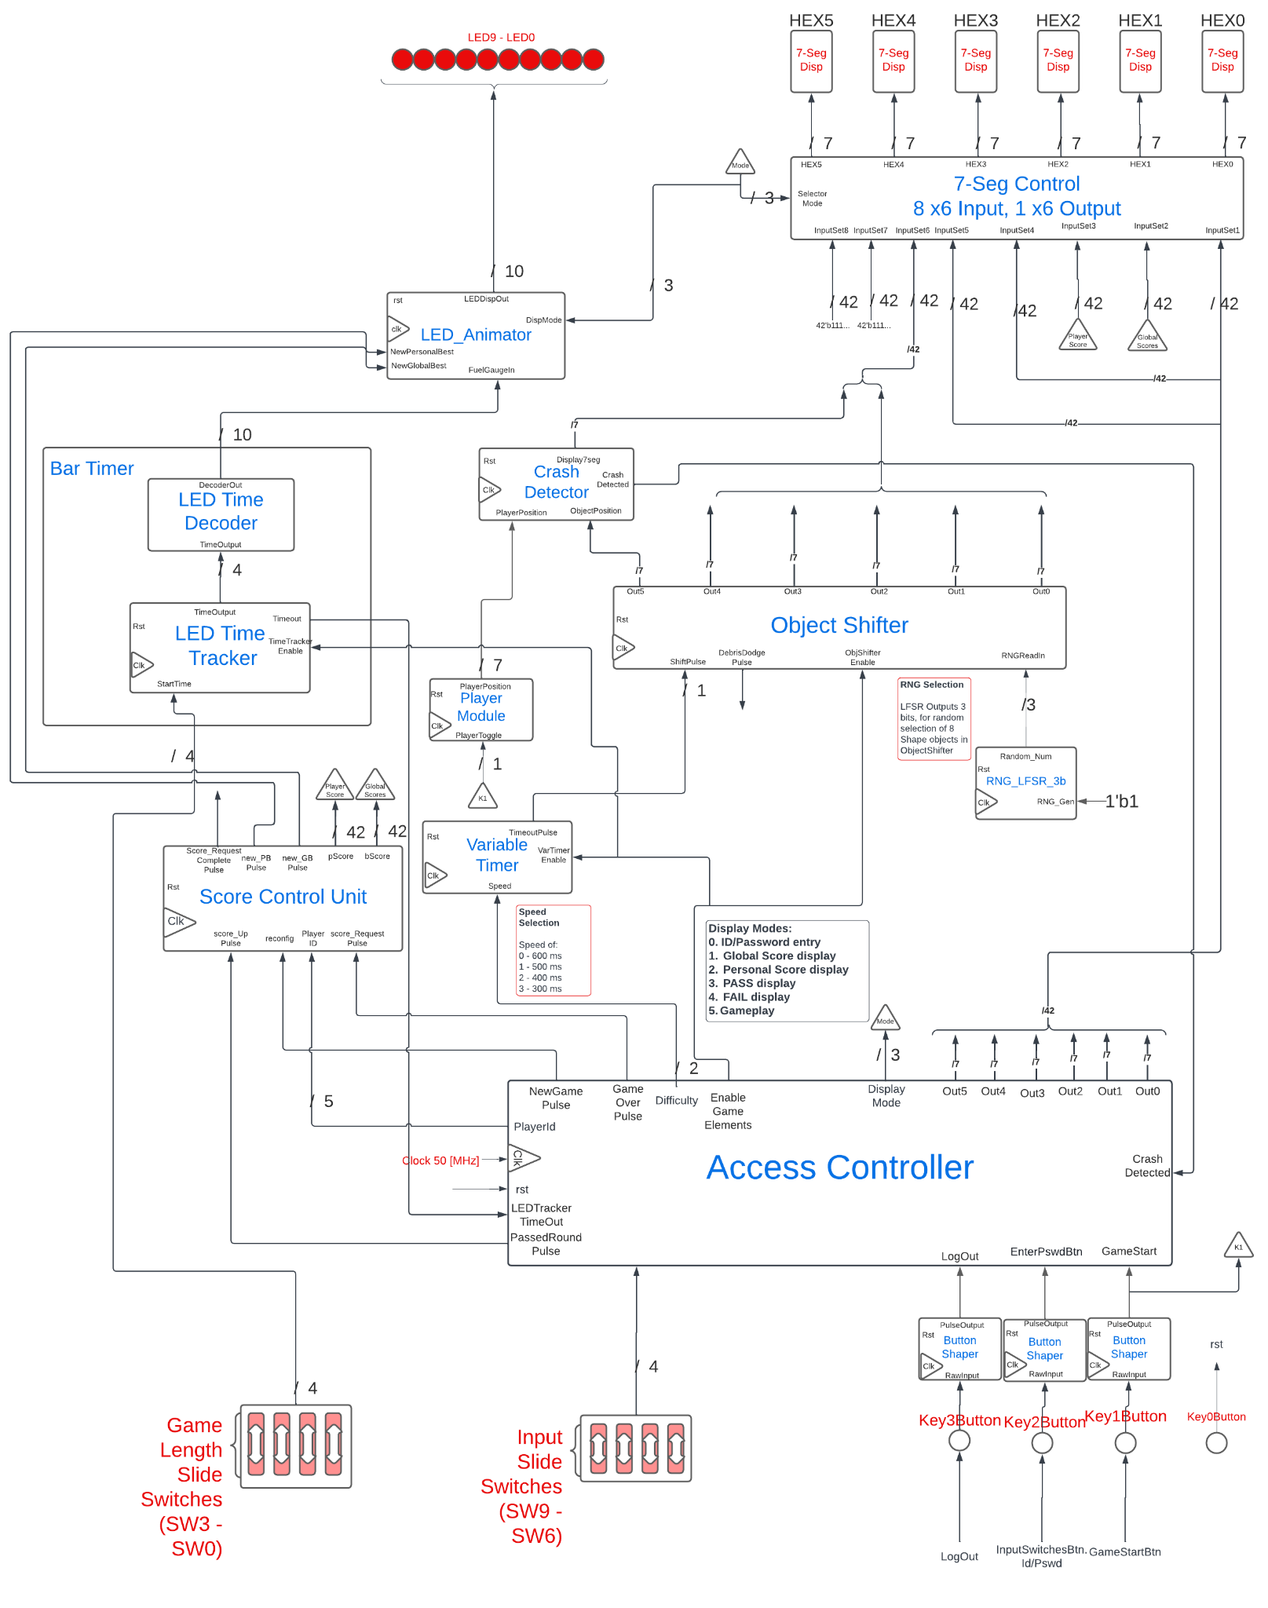
System Architecture
Score/Timer systems
Object Control
AccessControl/game Control
Graphical Systems
Notes:
chris

Slide 6
Access Controller
MultiUserAuthentication module handles authenticating user.
GameController module controls in game elements and output display modes
Timer Displays of Scores
Timer Display of Fail State
Display of Pass State
Notes:
[Gantabya]

Slide 7
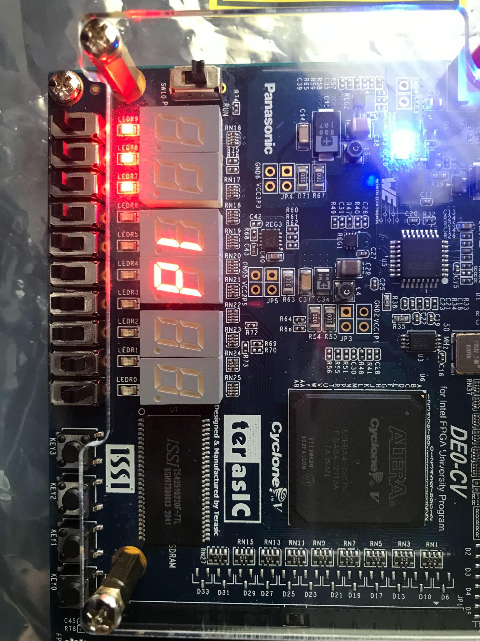
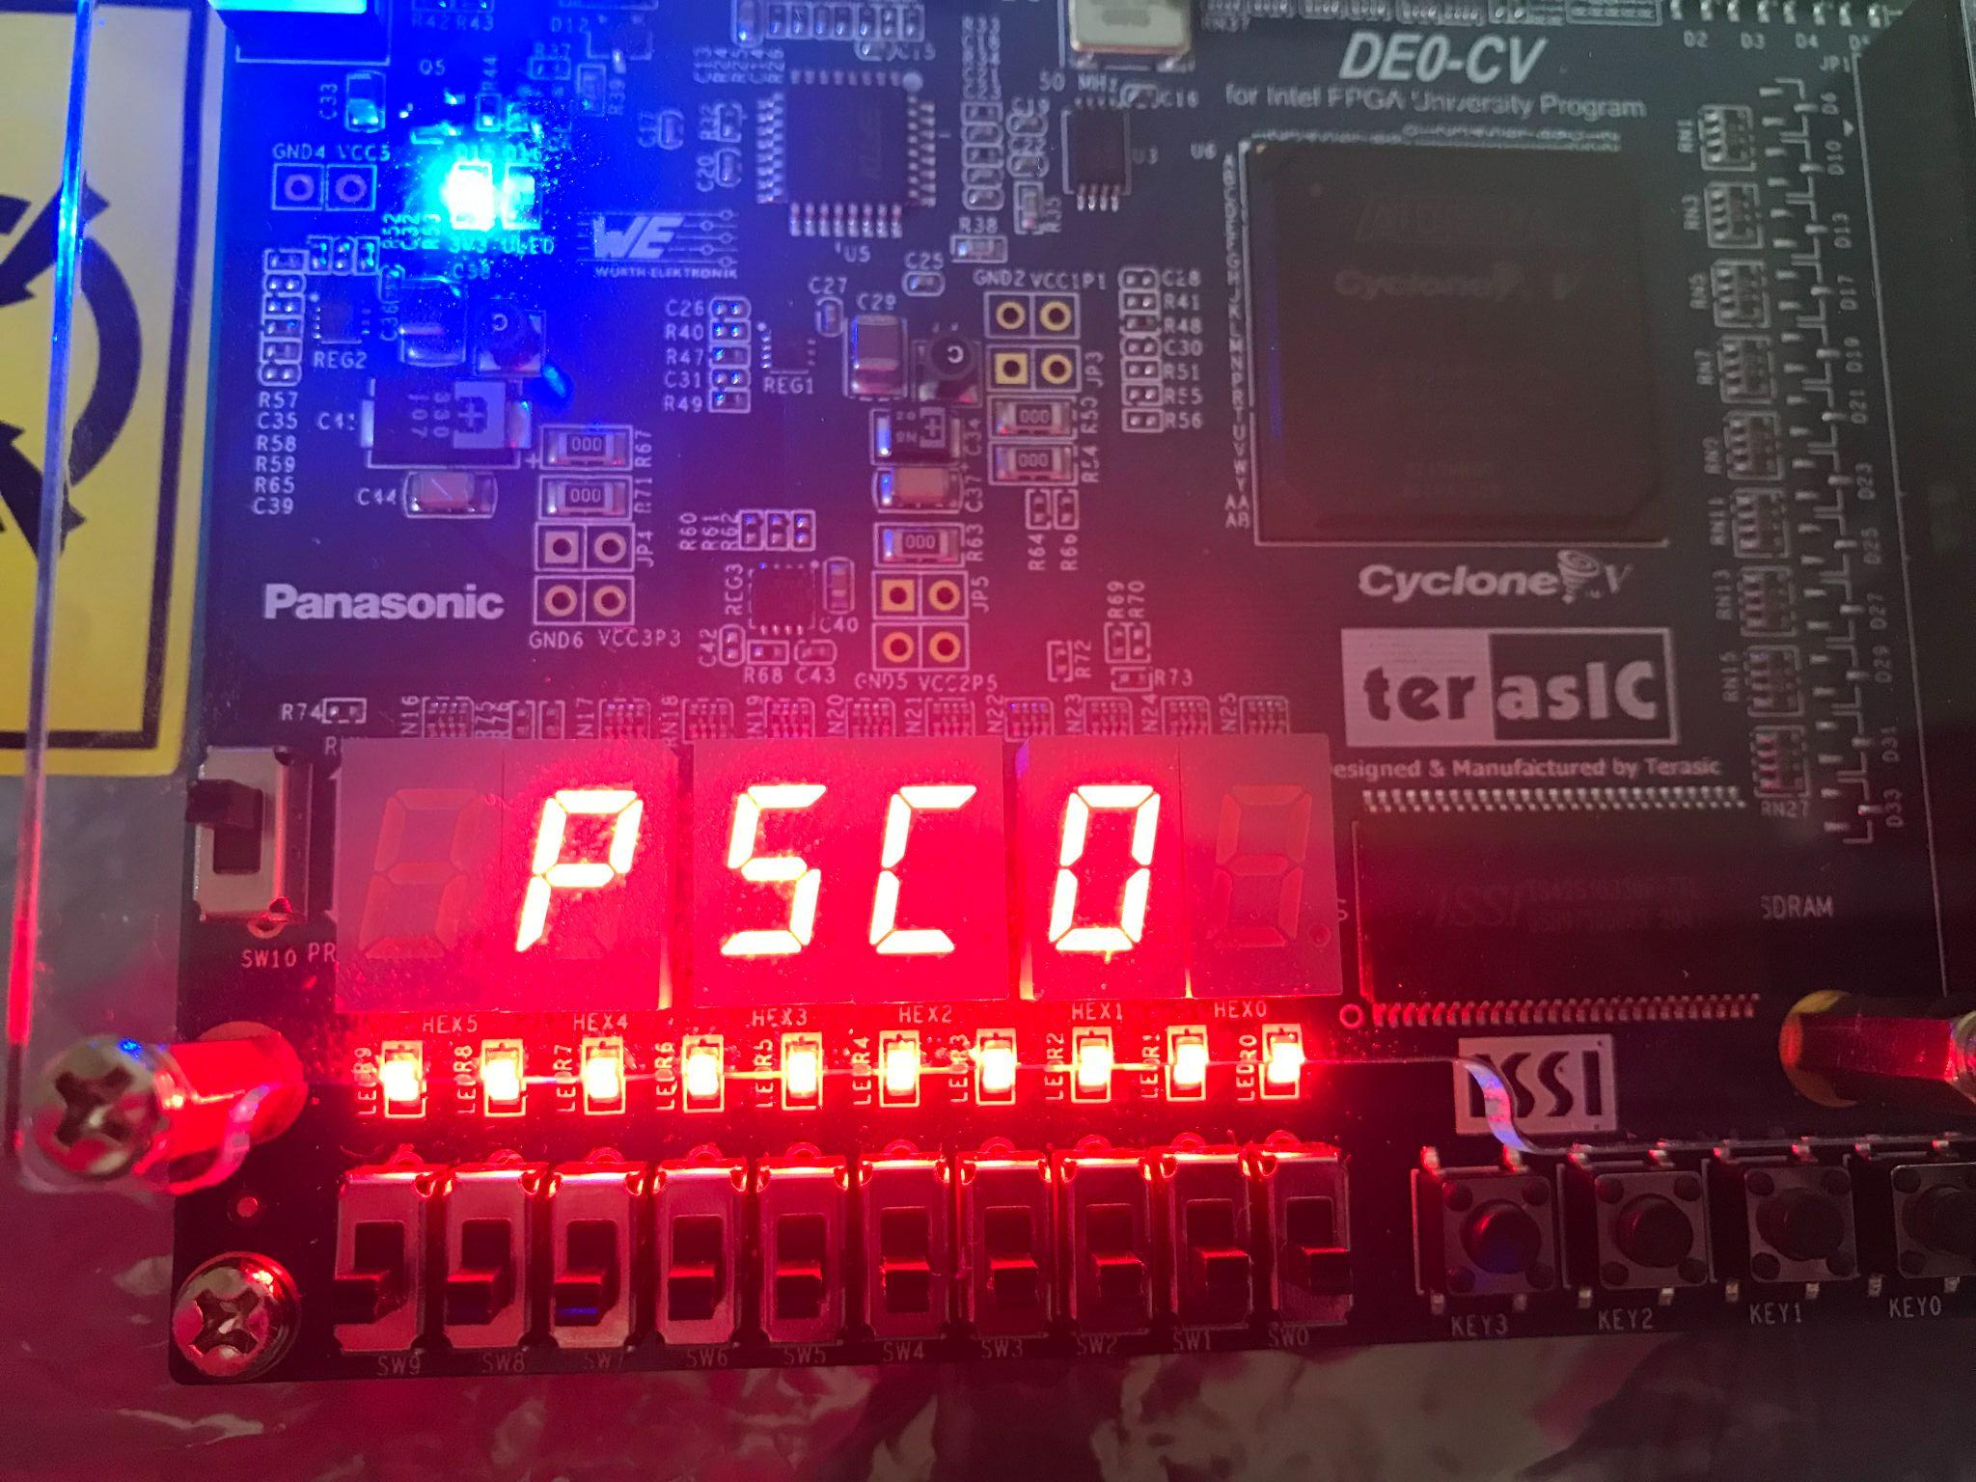
Displays During Authentication
ID
PSCO ⇒ Passcode
Notes:
[Gantabya]

Slide 8
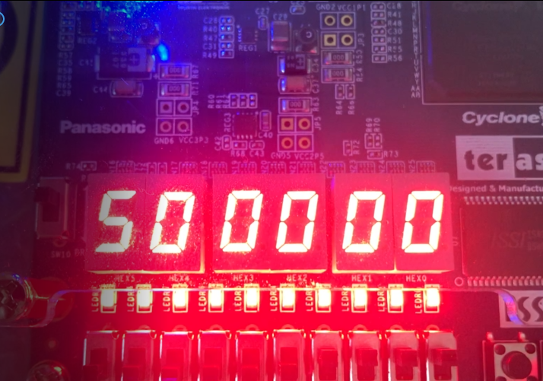
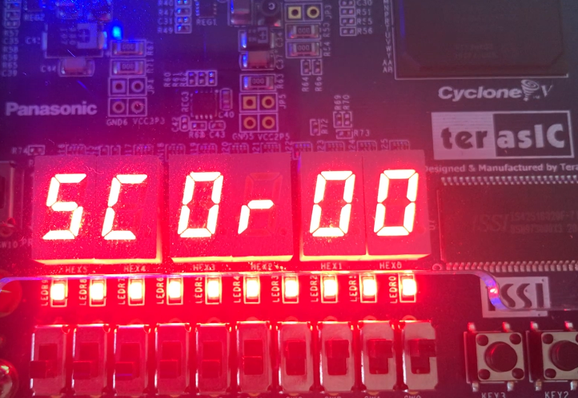
Display Transition Prior To Start
Logged-in Player Score Display
Global Score Display with Logged-in Player ID
Notes:
[Gantabya]

Slide 9
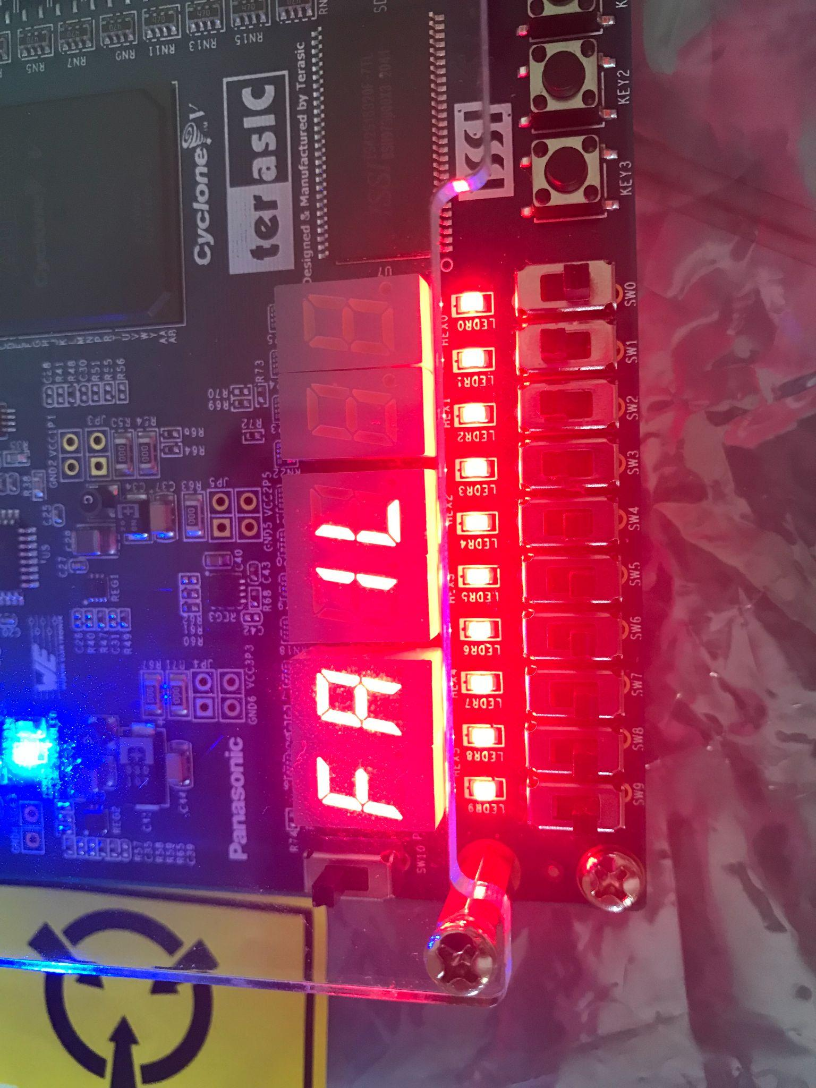
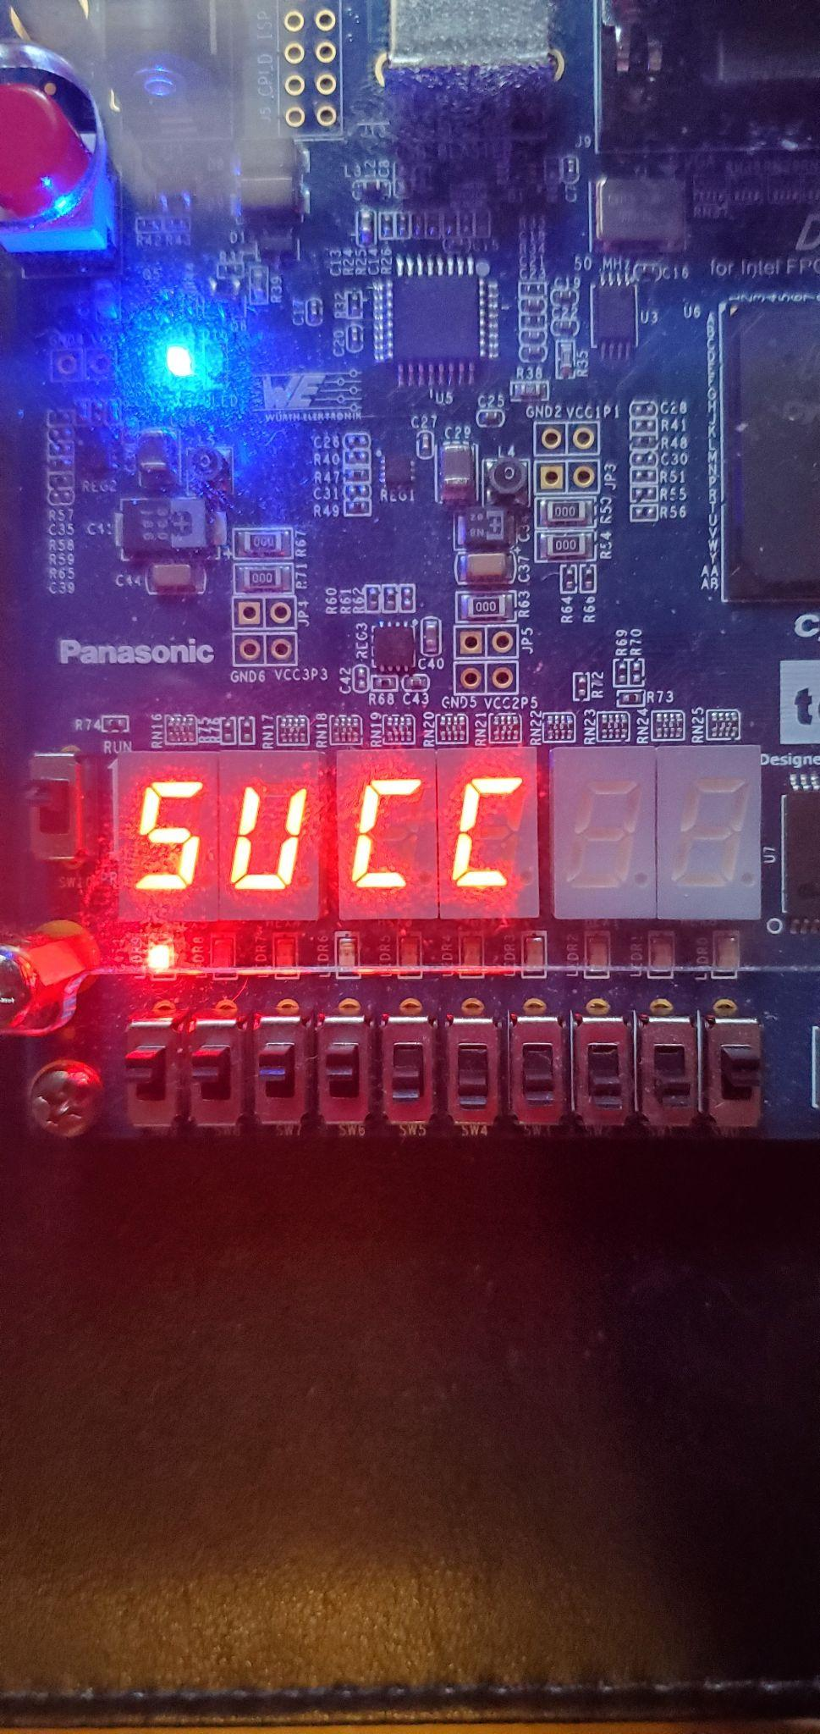
Displays Success or Failure Round
SUCC ⇒ Success
Fail
Notes:
[Gantabya]

Slide 10
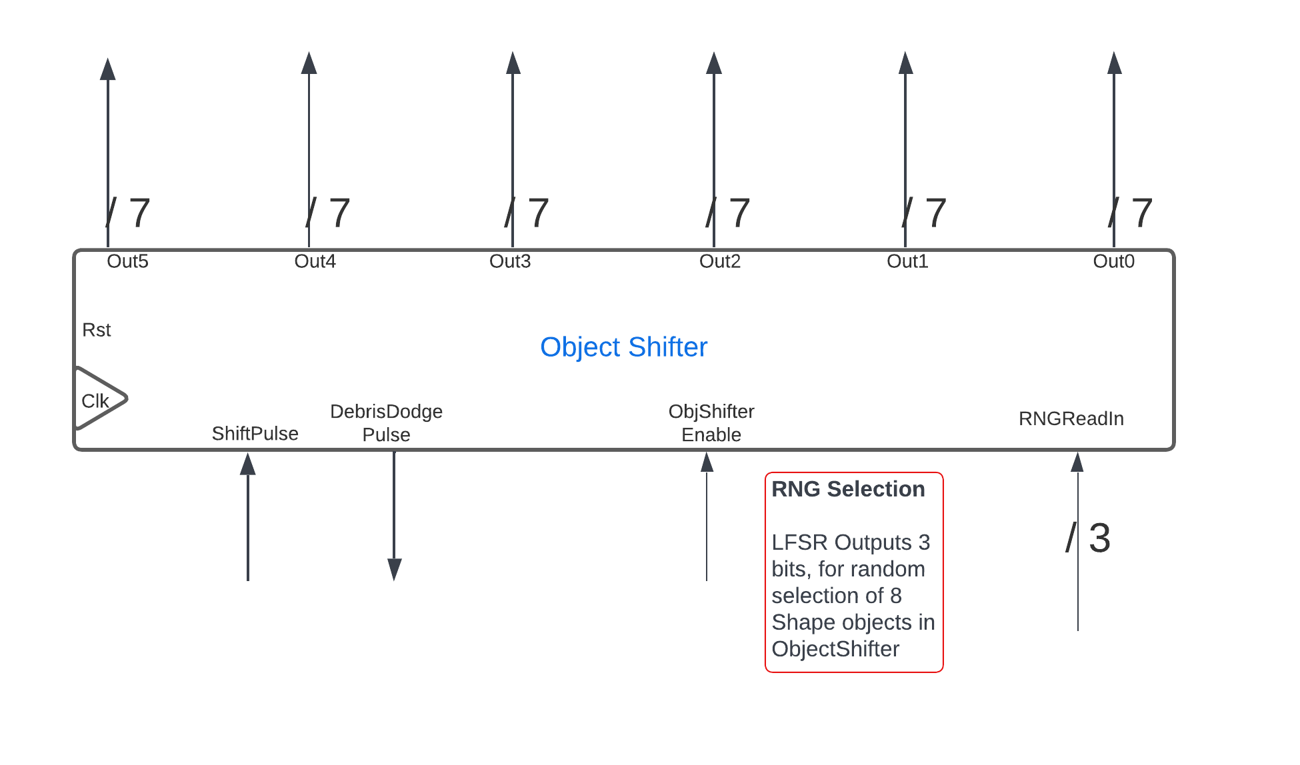
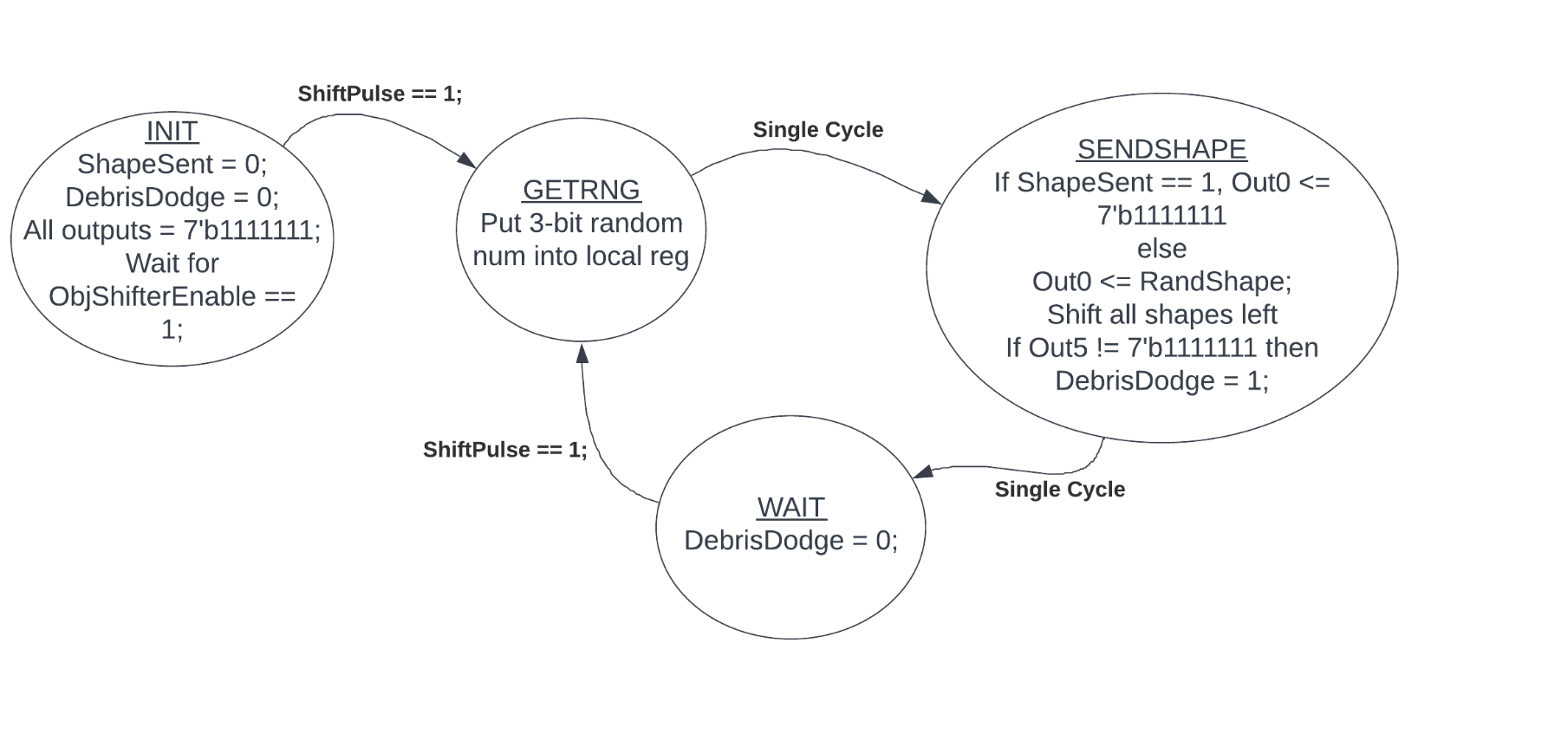
FPGA Object Shifter
Randomly Generated Objects
4 Top shapes
4 Bottom Shapes
Notes:
matt

Slide 11
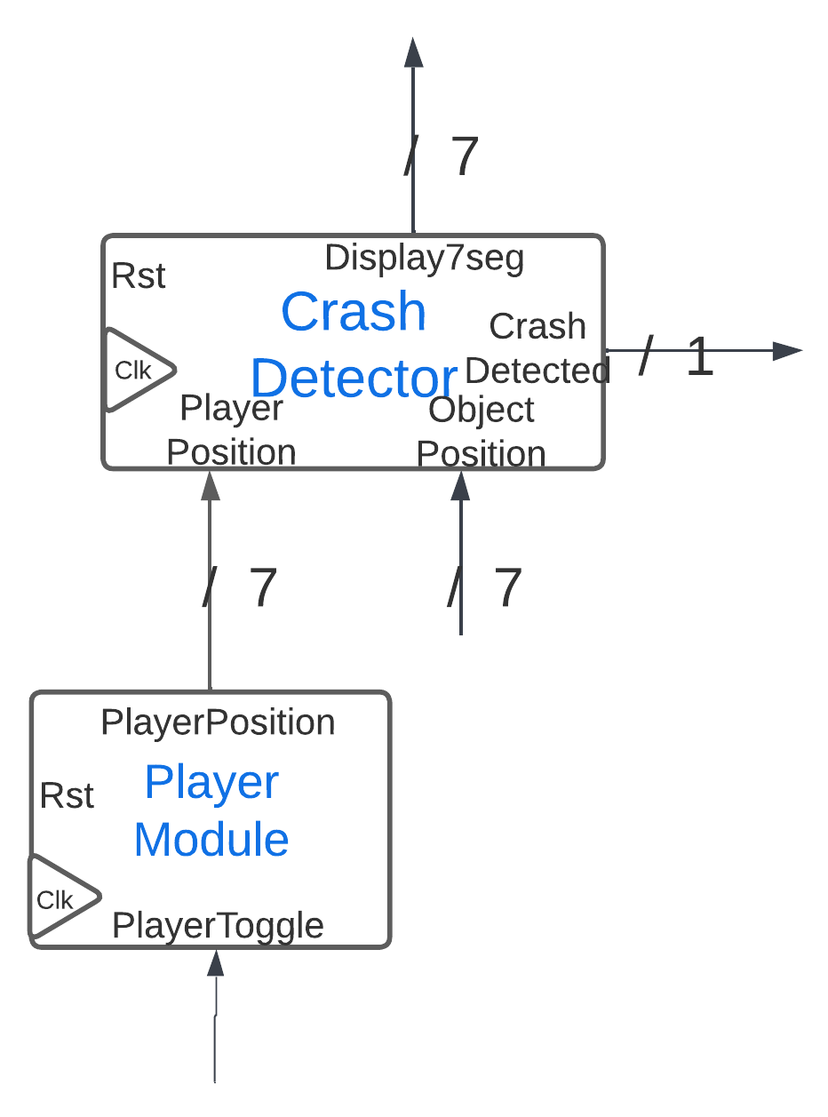
Crash Detector
Determines if the Player Position conflicts with Object position.
Given inverted 7seg logic, checks for matching 0’s only in leftmost position.
Outputs combination of Player and Object.
Notes:
Matt
The presentation should clearly describe the system your team is building, the features it has, and some design details (system architecture etc), and please focus more on the designs unique to your project. The required features can be detailed in the design document but keep them minimal in your presentation. The presentation should also include a short FPGA demo of the main feature of your system. You don't need to show the authentication part in the presentation. The full feature demo videos will be submitted separately.
Things Unique to our Game: User adjustable LED countdown timer, Randomly generated objects scrolling across display, timed score display screens, collision detector?, scorer controlled by game controller?, automatic difficulty increase with each SUCC?
Things to show in the FPGA demo: Reconfigurable LED Timer, Gameplay, SUCC, FAIL, global/personal high score overwrite (this will need to be prepped beforehand, like player 0 has global high score of 1, Player 1 gets 1 point and has a personal high score, on second play, Player 1 gets 2 points earning global high score? Also an opportunity to see the difficulty increase automatically)

Slide 12
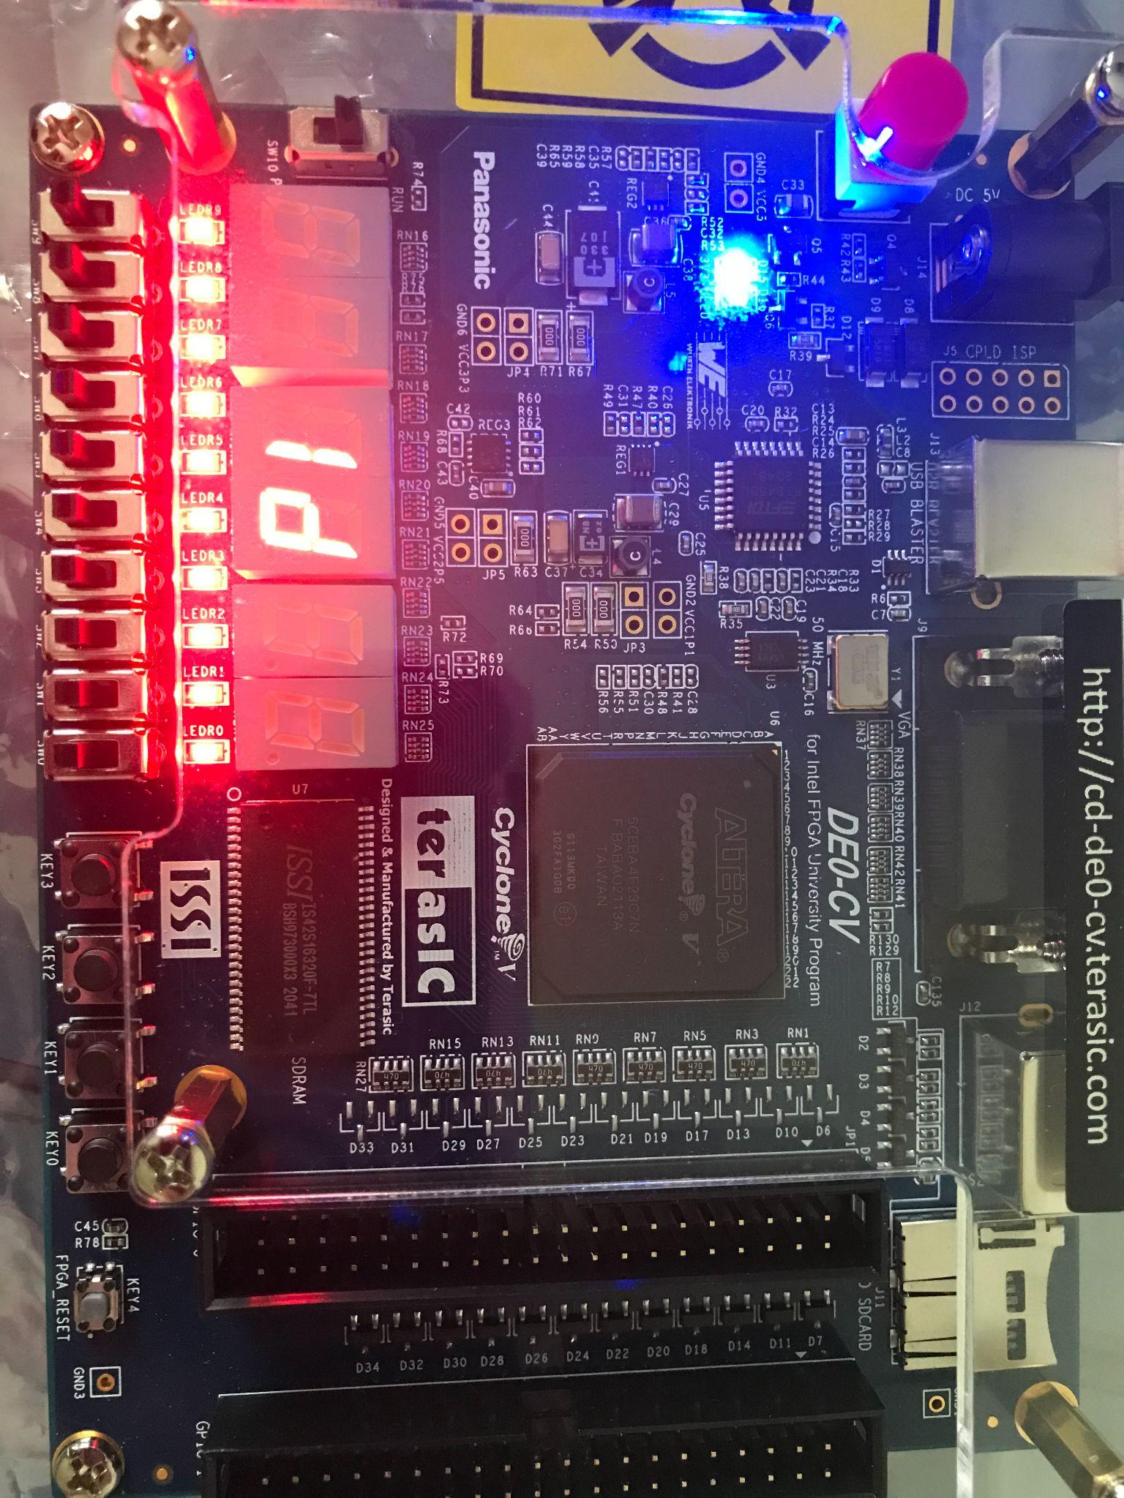
User Adjustable LED Timer
LED Timer is user configurable
Simulates “Fuel Gauge”
LED Animator module
Suppresses LED output while in Authentication mode
Flashes bar using variable timer for Personal Best score
Ramps from Low to High for Global Best
Notes:
Nhat

Slide 13
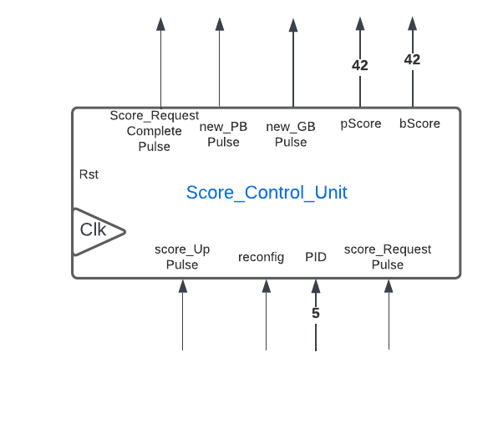

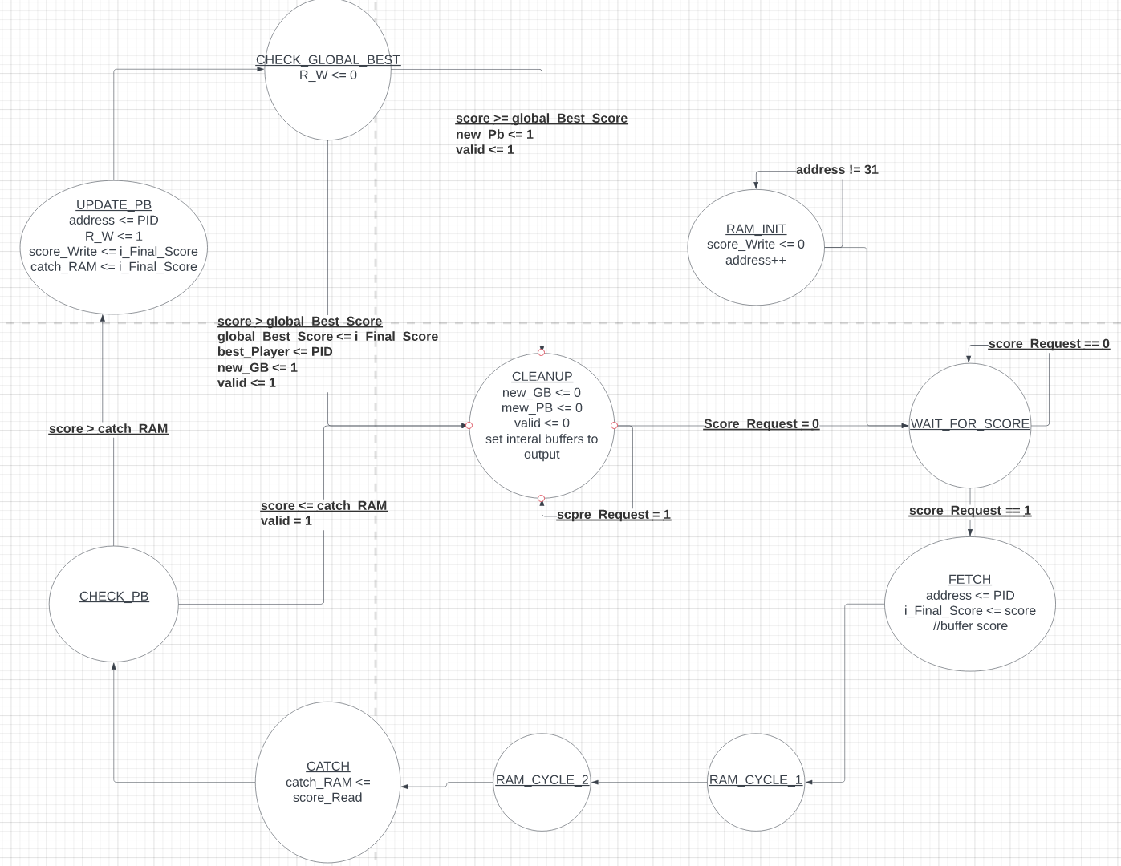
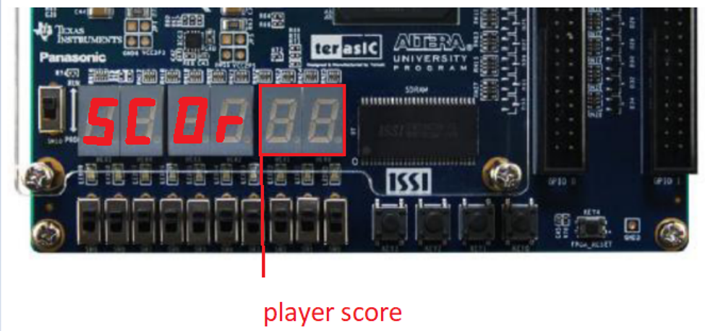
Score System
Notes:
Chris

Slide 14

Feature Demo
Notes:
matt

Slide 15
THANK YOU
Acknowledgements:
Dr. Yuhua Chen
Colby Inman
Zachary Dobert
Notes:
Matt

